Slide 1
Introduction to Reinforcement Learning
A mini course @ HCMUS, Vietnam
Lectures 7-9 (cont’d)
Long Tran-Thanh
long.tran-thanh@warwick.ac.uk
University of Warwick, UK

Slide 2
Multi-Armed Bandits

Slide 3

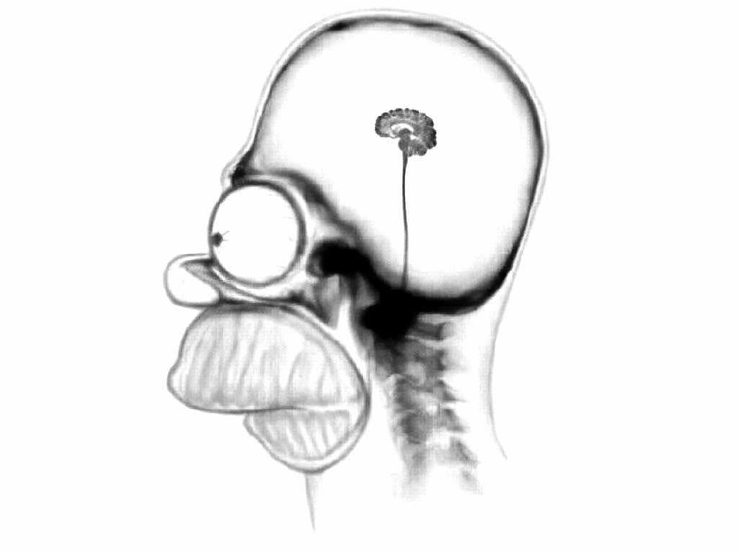

Optimisation problems in sequential decision making
Perception
Environment
Action
Until now, we focused more on the learning problem in SDM:
Learn the value function
Learn the optimal policy

Slide 4
Optimisation problems in sequential decision making
Perception
Environment
Action
Until now, we focused more on the learning problem in SDM:
Learn the value function
Learn the optimal policy
Example: episodic MDP -> learn the model as accurately as possible, given a number of episodes

Slide 5
Optimisation problems in sequential decision making
Perception
Environment
Action
Until now, we focused more on the learning problem in SDM:
Learn the value function
Learn the optimal policy
Question: What will we do if we need to find the optimal policy as quickly as possible, and then use it in the rest of the remaining episodes? (i.e., we need to perform at the same time while we are learning as well?)

Slide 6
Optimisation problems in sequential decision making
Perception
Environment
Action
Put differently:
Learning: Given T episodes, our goal is to find the best policy within this T episodes
Optimisation: Given T episodes, each delivers a return. We need to maximise our total return over T episodes

Slide 7
Optimisation problems in sequential decision making
Perception
Environment
Action
Put differently:
Learning: Given T episodes, our goal is to find the best policy within this T episodes
Optimisation: Given T episodes, each delivers a return. We need to maximise our total return over T episodes
New challenge: exploration vs. exploitation

Slide 8


Exploration vs. Exploitation
Trade-off
Exploration
Exploitation
(learn the reward values)
(optimise the rewards over time)
Too much exploitation: not enough information -> suboptimality
Too much exploration: not enough time to optimise -> suboptimality

Slide 9
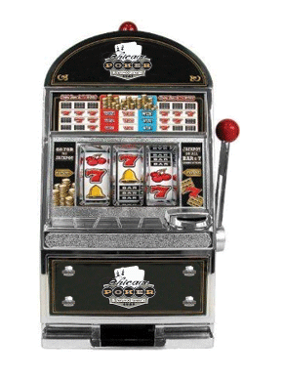
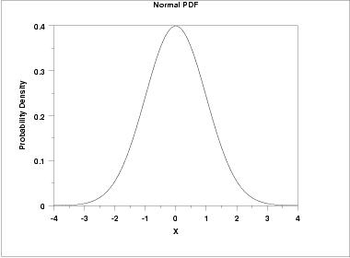
One-armed bandit
Reward value is drawn from unknown distribution

Slide 10
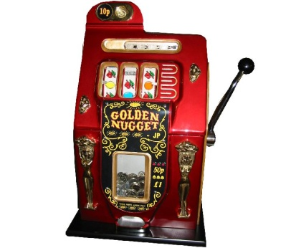
The multi-armed bandit (MAB) model
There are multiple arms
At each time step (round):
We choose 1 arm to pull
Receive a reward, drawn from an unknown distribution of that arm
Objective: maximise the expected total reward
Exploration: we want to learn each arm’s expected reward value
Exploitation: we want to maximise the sum of the rewards
MAB is the simplest model that captures the dilemma of exploration vs. exploitation

Slide 11
How to solve MAB problems?
We don’t have knowledge about the expected reward values at the beginning.
But we can learn these values through exploration.
However, this indicates that we have to pull arms that are not optimal (to learn that they are not optimal).
We cannot achieve the optimal solution, which would be to pull the optimal arm (the one with the highest expected reward value) all the time.
Our goal: design algorithms that are close to the optimum as much as possible (= good approximation)

Slide 12
Performance of bandit algorithms
So if we cannot achieve the best possible, then what else can we do?
Answer: we can aim to design algorithms that have close performance to that of the best possible
A performance measurement metric: regret
Regret: the difference between the (expected) performance of an algorithm with that of the best possible

Slide 13
No-regret algorithms
Regret is defined over a finite number of time steps (in the example, it was 100 time step).
Average regret: = regret divided by the number of time steps (i.e., it measures how much is our regret on average at each time step)
No-regret algorithm: = if the average regret of the algorithm converges to 0 as the size of horizon (i.e., number of time steps) goes to infinity
Example: an algorithm with the following regrets
Time horizon size (T) | 100 | 200 | 300 | … | 10,000
Regret (R) | 10 | 14.1 | 17.3 |  | 100
In general, the algorithm has regret R = where T is the time horizon
The average regret in this case is for each time horizon T -> no-regret (as it converges to 0)

Slide 14
The UCB algorithm for MABs
Assumption: all the rewards are between 0 and C
Initial phase: pull each arm once
Main phase:
: the arm we pull at time step t
: the number of times we have pulled arm I up to t
: average reward of arm i at t
UCB index of arm i:
Pulling policy: pull the arm with highest UCB index (= i(t))
Update knowledge (number of pulls, average reward) of i(t)

Slide 15
A useful lemma: Hoeffding’s inequality
Hoeffding’s inequality:

Slide 16
The intuition behind UCB
The UCB index captures both: the estimated expected reward value
& the uncertainty about this estimation
is very small (by Hoeffding)
Choosing the highest UCB index captures both: exploitation and exploration
high UCB index = worth to exploit (high expected reward)
or worth to explore (high uncertainty)

Slide 17
Regret bounds
Upper bound of the regret:
Theorem1: the expected regret of UCB is at most O(lnT)
Lower bound of the regret:
Let F(T) is a function of T: F(T) is a lower bound of the regret, if no algorithm can achieve better regret than F(T)
More precisely: for any algorithm A, there exists a setting S(A), such that within that setting, A cannot achieve better (i.e., lower) regret than F(T)
The regret lower bound of the multi-armed bandits is
Implication: the regret bound of UCB is asymptotically optimal

Slide 18
Proof Sketch
Simplified proof: 2 arms, C = 1 (i.e., rewards are between 0 and 1)
W.l.o.g. assume that Arm 1 is better than Arm 2:
Let
Lemma 1: the expected number of pulls of Arm 2 is at most
Theorem 2: the expected regret of UCB is at most – proof: use Lemma 1

Slide 19
Proof Sketch of Lemma 1
At each t, when we pull Arm 2 instead of Arm 1? (i.e., we pull the sub-optimal arm?)
Answer: when UCB index of Arm 2 > UCB index of Arm 1
Let
We now provide upper bound for

Slide 20
Proof Sketch of Lemma 1
Claim:
Proof: if UCB2 > UCB1 happens, then at least one of these also holds:

Slide 21
Proof Sketch of Lemma 1
Claim:
Proof: use Hoeffding’s inequality:
(from Hoeffding)

Slide 22
Proof Sketch of Lemma 1
Similarly:
Finally, we investigate the case of
We have that if , this cannot happen because:

Slide 23
Proof Sketch of Lemma 1
Why this is good for us?
Expected number of pulls of Arm 2:
If number of pulls of Arm 2 is large enough, say , we have that UCB2 > UCB1 is very unlikely (~ 2t^{-4})
Carefully summing up -> we get the upper bound of
Note: well known fact (using Riemann’s Zeta function):
Q.E.D.

Slide 24
Summary: (stochastic) multi-armed bandits
Very simple model for sequential decision making under uncertainty
Captures the exploration vs. exploitation dilemma
Efficient algorithms: UCB (and many more)
Many application domains: internet search (Bing), recommender systems, online advertisement (keyword bidding), hyperparameter optimisation in ML, discrete optimisation, ...

Slide 25
Adversarial Bandits

Slide 26
Motivation 1: learning in dynamic environments
Reward/feedback
Decision making process
Environment
Execute action
Environment:
Stochastic: governed by some underlying stationary stochastic process
Stochastic bandits: the bandit models we’ve learnt so far
What about more dynamic/hostile environments?

Slide 27
Motivation 2: learning against “smart” opponents
Learning against nature:
Oblivious -> doesn’t care about your actions
Typically stochastic environment
Learning against opponents who can also learn:
Same game is (repeatedly) played multiple times
If the opponent follows some underlying policy (e.g., she always chooses B if we choose A), then we can aim to learn this from the previous observations

Slide 28
Non-stochastic setting
Non-adversarial:
Changes in the environment/nature: ranging from slow and smooth to rapid and hectic
E.g., control systems, real-world (natural) environments
Adversarial:
Malicious: adaptive, non-adaptive
E.g., repeated games

Slide 29
Why stochastic bandit algorithms don’t work?
Iterated Rock-Paper-Scissor
Opponent: chooses Rock in the first 100 rounds, then plays Paper in the next 200s, then Scissor in the following 300s, etc…
We don’t have this information
Stochastic bandit algorithms (e.g., UCB) won’t be able to cope with these changes (Why?)

Slide 30
Why stochastic bandit algorithms don’t work?
Stochastic bandit algorithm with low regret bound = after a certain point, we rarely pull a sub-optimal arm
This is learnt based on previous feedback
If the environment changes, we can only slowly adapt to the changes, or cannot even detect it
Workaround solutions: time window, forgetting factor, etc…
Only work for restricted settings

Slide 31
Adversarial bandits
There are K arms
Adversarial opponent
At each time step (round):
The adversary assigns reward values to the arms
We choose 1 arm to pull: receive a reward chosen by the opponent
Important: the opponent has to assign the rewards of that round before we choose!!!
The opponent can be oblivious: she doesn’t care about our decision making process
The opponent can be adaptive: she can see our previous choices + rewards, and adapt the assigned values based on this

Slide 32
Example
Adversarial opponent has to assign a total of 5 between 2 arms
Previous rounds:
 | t=1 | t=2 | t=3 | t=4 | t=5
Arm 1 | 3 | 4 | 1.5 | 0 | 4
Arm 2 | 2 | 1 | 3.5 | 5 | 1
Oblivious opponent:
Assigns Arm1 = 5, Arm2 = 3 (no particular reason)
In general: the opponent assigns the values to all time steps before the game starts
Adaptive opponent:
Arm2 was played more often: Arm1 = 5, Arm2 = 0

Slide 33
Difficulties in adversarial bandits
Optimal solution: have full prior knowledge about the assignment per each time step of the opponent
Very difficult to learn, even against oblivious opponents
One reason: historical data does not give much help in predicting the future (no statistical correlations to learn)
Consequence: the regret against the optimal solution can be arbitrarily bad
We need different regret definitions

Slide 34
Internal vs. external regret
External regret: we compare our algorithm against the best fixed arm policy in hindsight
Fixed policy: we repeatedly pull the same arm
Best fixed policy: not efficient as the optimal solution, but still a non-trivial (& intelligent) policy
Internal regret: we compare our algorithm against another one which only differ from ours in the following way:
We choose two particular arms, say a1 and a2
We replace every pull of a1 with a2 in the new algorithm
Internal regret = comparison against the best possible replacement in hindsight

Slide 35
Internal vs. external regret
We focus on external regret
Original regret notation (Hannan 1957), whereas internal regret was introduced by Foster & Vohra (1998)
Blum & Mansour (2007) showed that the two are interchangeable:
Any algorithm with efficient internal regret can be modified to have low external regret, and vice versa

Slide 36
Formal model of adversarial bandits
K arms = {1,2,…,K}
At each time step t:
Opponent chooses a vector:
We choose an arm:
Objective: find a sequence of pulls
Best fixed policy on hindsight
A can be randomized

Slide 37
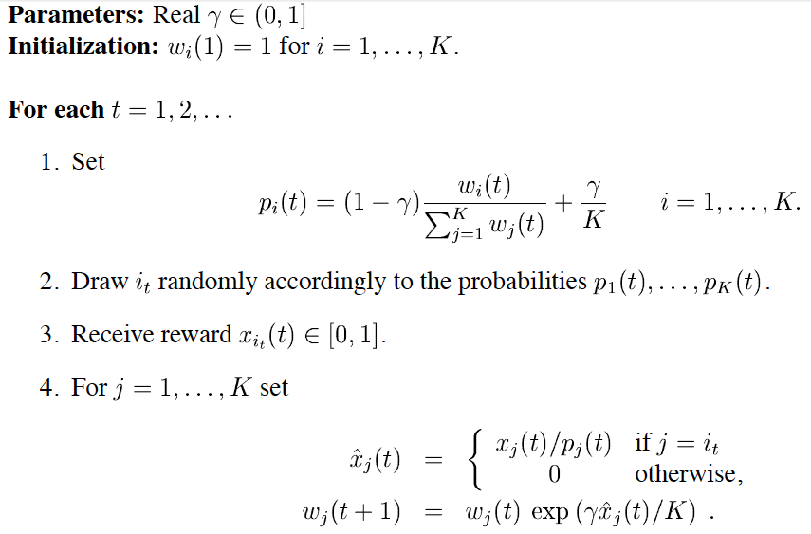
The Exp3 algorithm

Slide 38
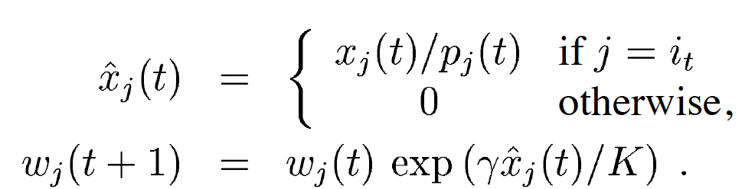
The Exp3 algorithm explained
Updating the weights
Weight value remains the same if arm not pulled (exponential part = 1)
Exponential growth significantly increases weight of good arms
Arms which are better in the best has higher weights
Recall that we want to learn the best arm in hindsight

Slide 39
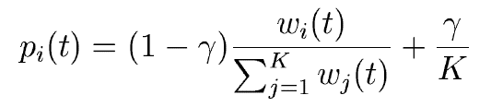
The Exp3 algorithm explained
Pulling probability of arm i at time step t :
With probability , it prefers arms with higher weights (exploit)
With probability , chooses to uniformly randomly explore
Exp3 randomly pulls an arm, receives the rewards, then updates the weights

Slide 40
Regret analysis of Exp3
Theorem: the (external) regret of Exp3 is at most:
Theorem: the (external) regret for any bandit algorithm is at least
Notes:
TODO: do the proof on white board

Slide 41
The Follow the Perturbed Leader (FPL) algorithm
Parameters:
Initialisation:
For each t = 1,2,…T:
For each arm generate a random noise from an exponential distribution:
Pull arm I(t):
Add noise to each arm and pull the one with the highest value
Update value:
The rest remains the same

Slide 42
The FPL algorithm explained
We follow the arm that we think has the best performance so far
We add the exponential noise to it to provide exploration
Hence the name
Intuition behind this: again, we want to learn the best arm in hindsight
Properties:
Much simpler than Exp3, but has worse performance guarantees
But improved versions have efficient regret bounds too!
Notes:
Say that we skip the proof due to time constraints

Slide 43
Exp3 vs. FPL
Exp3
FPL
Maintains weights for each arm to calculate pulling probability
Doesn’t need to know the pulling probability per arm
Has efficient theoretical guarantees
The standard FPL does not have good theoretical guarantees
Might be computationally expensive (calculating the exponential terms)
Computationally quite efficient

Slide 44
Monte-Carlo Tree Search + UTC

Slide 45
Simulation based search in RL
World simulator: we can simulate the underlying MDP
That is, we can simulate episodes of experience from now with the model starting from any current state s
We can apply model-free RL to simulated episodes
Monte-Carlo learning -> Monte-Carlo search
SARSA -> TD search

Slide 46
Monte-Carlo search
World simulator: we can simulate the underlying MDP
That is, we can simulate episodes of experience from now with the model starting from any current state
Evaluate action value by average return
Select current action with the highest Q-value:
This is actually 1-step lookahead calculation

Slide 47
Forward search with expectimax tree
Question: can we do better than 1-step lookahead?

Slide 48
Forward search with expectimax tree
Question: can we do better than 1-step lookahead?
Forward search: select the best action by full lookahead
Fully build a search tree with the current state s_t at the root
Using a model of the MDP to look ahead
No need to solve whole MDP, just sub-MDP starting from now

Slide 49
Forward search with expectimax tree
Main issue: size of sub-tree can be very large:

Slide 50
Monte-Carlo tree search (MCTS)
Similarly to expectimax trees, it also builds a tree rooted at current state s_t
But it samples actions and next states, instead of fully build the tree
Performs K simulation episodes starting from the root state
After K simulations, select current (real) action with maximum value in search tree:

Slide 51
Upper confidence bound in trees (UCT)
In MCTS, we do the simulation part with uniformly randomly choosing actions
Question: can we do more efficiently than that?

Slide 52
Upper confidence bound in trees (UCT)
In MCTS, we do the simulation part with uniformly randomly choosing actions
Question: can we do more efficiently than that?
UCT:
Borrow idea from bandit literature and treat each node where can select actions as a multi-armed bandit (MAB) problem
Maintain an upper confidence bound (UCB) over reward of each arm

Slide 53
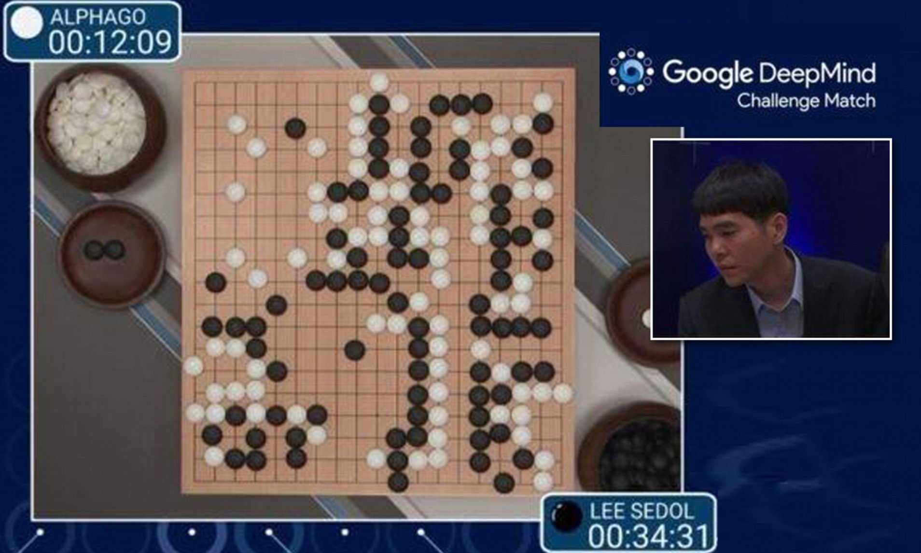
Application of UCT:

